Slide 1

VECTORS IN $ℝ^{n}$
MATH 15 - Linear Algebra

Slide 2
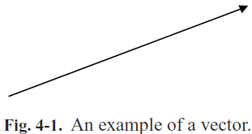
VECTOR
A vector is a quantity that has both magnitude and direction. Mathematically, we can represent a vector graphically in the plane by a directed line segment or arrow that has its tail at one point and the head of the arrow at a second point, as illustrated in Fig. 4-1.

Slide 3
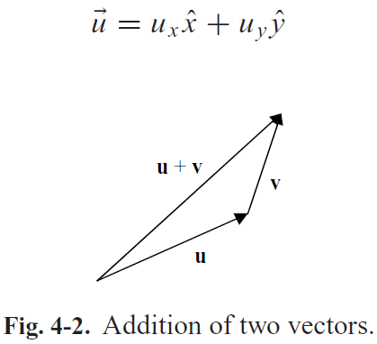
VECTOR
Two vectors can be added together using geometric means by using the parallelogram law. To add two vectors u and v, we place the tail of v at the head of u and then draw a line from the tail of u to the tip of v. This new vector is u + v.

Slide 4
PROPERTIES OF VECTOR
Add or subtract two vectors, giving us another vector.
Multiply a vector by a scalar, giving another vector that has been stretched or shrunk.
Form a scalar product or number from two vectors by computing their dot or inner product.
Find the angle between two vectors by computing their dot product.
Describe a zero vector, which, when added to another vector, leaves that vector alone.
Find an inverse of any vector , which when added to that vector, gives the zero vector.
Represent a vector with respect to a set of basis vectors, which means we can represent the vector by a set of numbers.

Slide 5
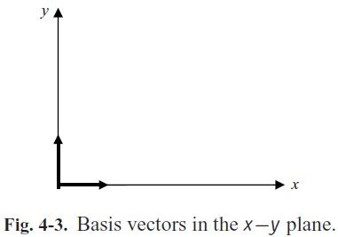
BASIS VECTOR
A basis vector has unit length.

Slide 6
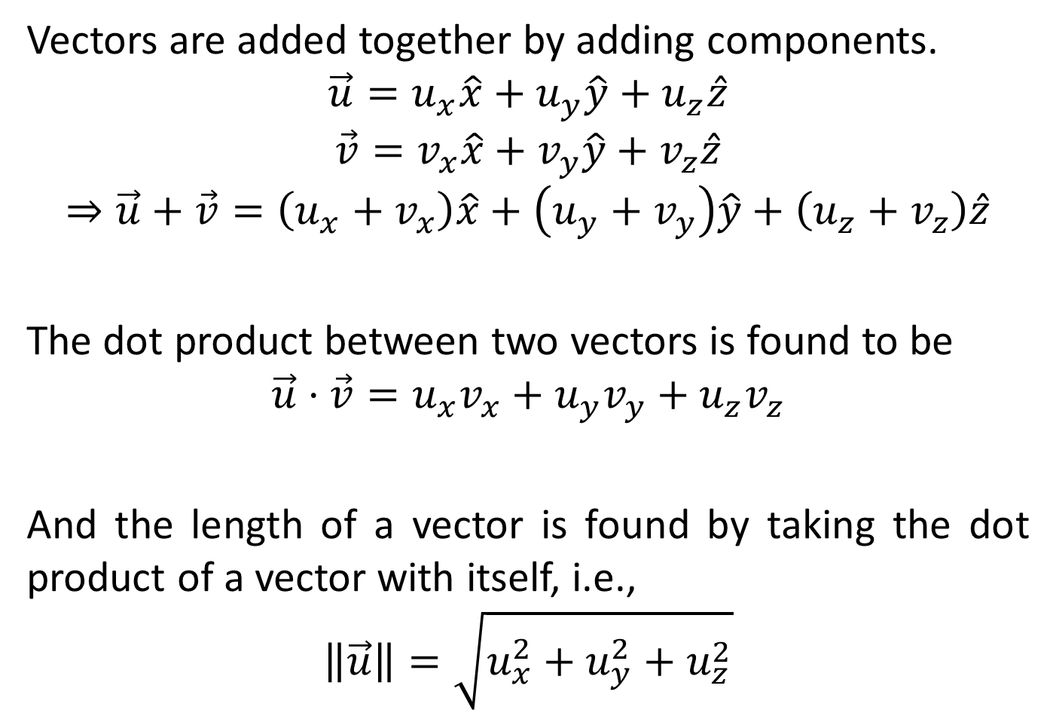
VECTOR
Vectors are added together by adding components.
$$\vec{u}=u_{x}\hat{x}+u_{y}\hat{y}+u_{z}\hat{z}$$
$$\vec{v}=v_{x}\hat{x}+v_{y}\hat{y}+v_{z}\hat{z}$$
$$⇒\vec{u}+\vec{v}=\left(u_{x}+v_{x}\right)\hat{x}+\left(u_{y}+v_{y}\right)\hat{y}+\left(u_{z}+v_{z}\right)\hat{z}$$
The dot product between two vectors is found to be
$$\vec{u}⋅\vec{v}=u_{x}v_{x}+u_{y}v_{y}+u_{z}v_{z}$$
And the length of a vector is found by taking the dot product of a vector with itself, i.e.,
$$\left\|\vec{u}\right\|=\sqrt{u_{x}^{2}+u_{y}^{2}+u_{z}^{2}}$$

Slide 7
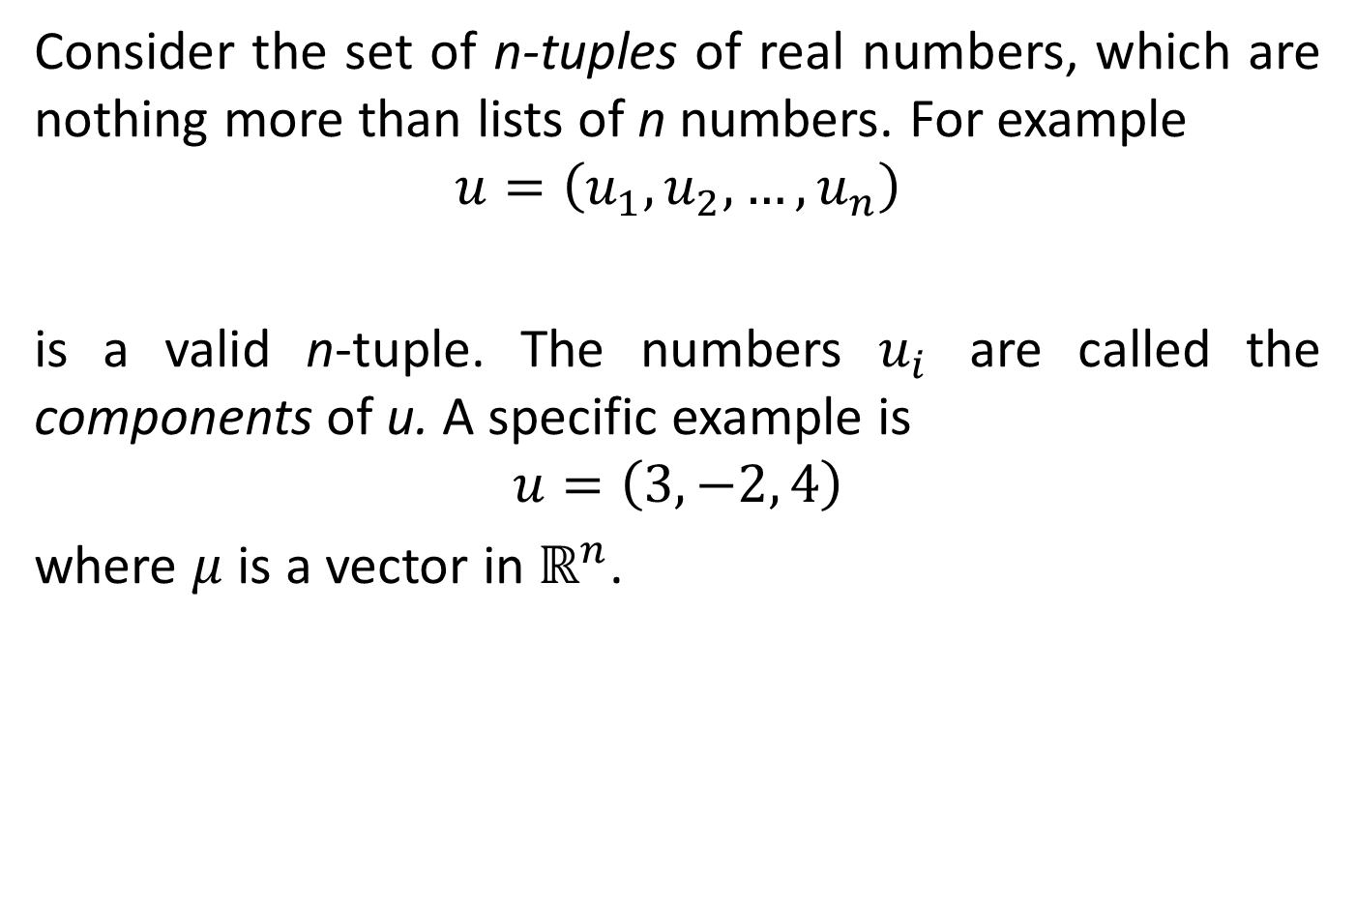
VECTOR
Consider the set of n-tuples of real numbers, which are nothing more than lists of n numbers. For example
$$u=\left(u_{1}, u_{2}, …,u_{n}\right)$$
is a valid n-tuple. The numbers $u_{i}$ are called the components of u. A specific example is
$$u=\left(3, −2, 4\right)$$
where $μ$ is a vector in $ℝ^{n}$.

Slide 8
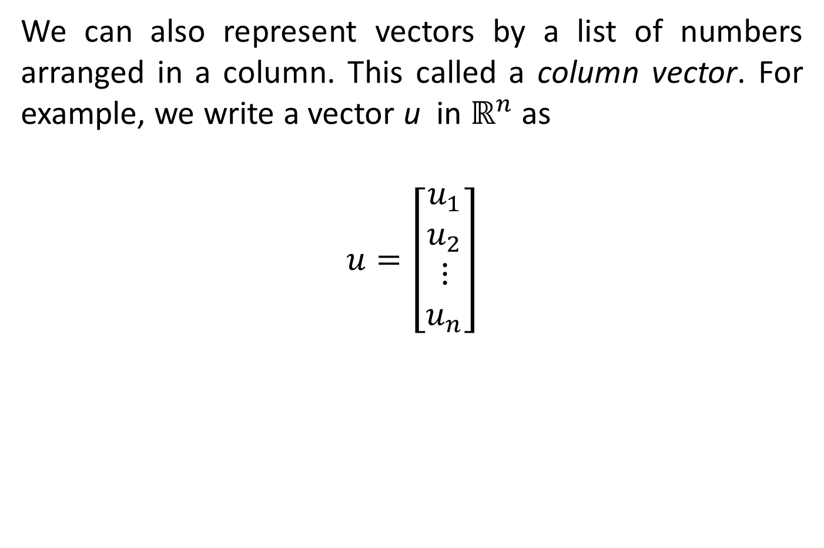
VECTOR ADDITION
We can also represent vectors by a list of numbers arranged in a column. This called a column vector. For example, we write a vector u in $ℝ^{n}$ as
$$u=\left[\begin{matrix}u_{1} \\ u_{2} \\ ⋮ \\ u_{n}\end{matrix}\right]$$

Slide 9
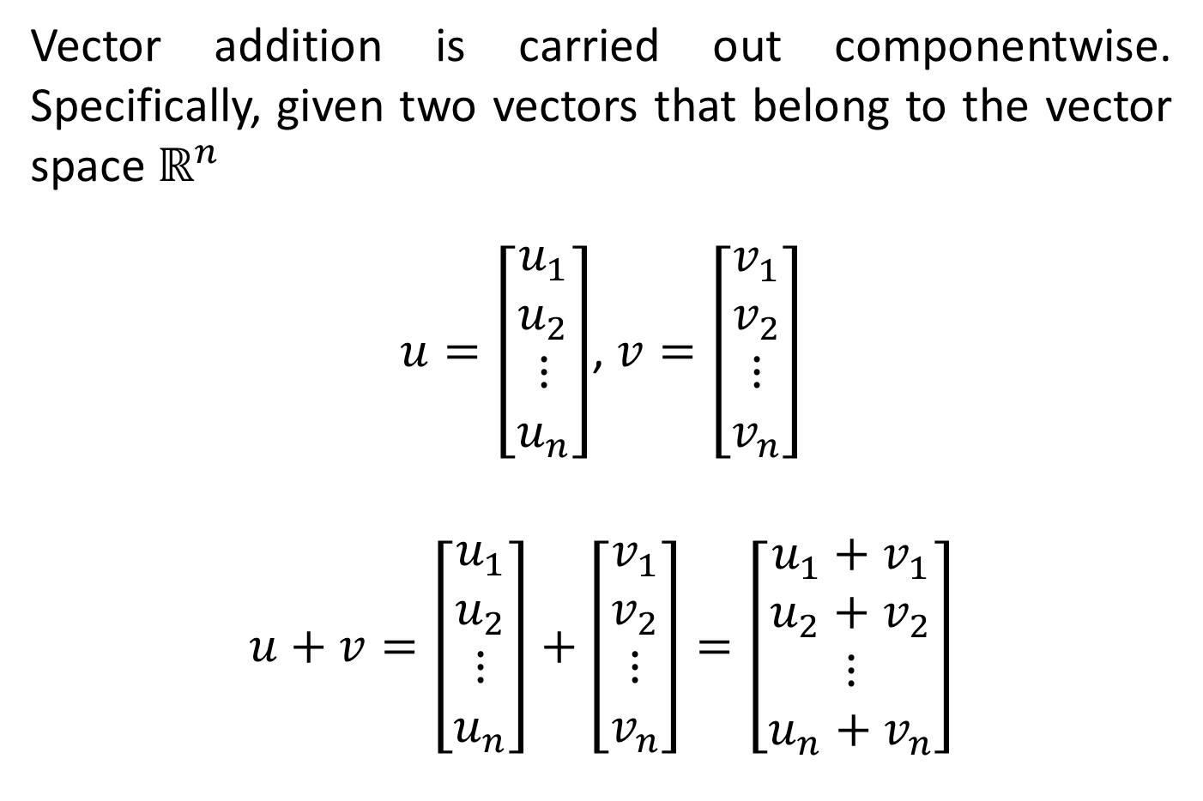
VECTOR ADDITION
Vector addition is carried out componentwise. Specifically, given two vectors that belong to the vector space $ℝ^{n}$
$u=\left[\begin{matrix}u_{1} \\ u_{2} \\ ⋮ \\ u_{n}\end{matrix}\right]$, $v=\left[\begin{matrix}v_{1} \\ v_{2} \\ ⋮ \\ v_{n}\end{matrix}\right]$
$$u+v=\left[\begin{matrix}u_{1} \\ u_{2} \\ ⋮ \\ u_{n}\end{matrix}\right]+\left[\begin{matrix}v_{1} \\ v_{2} \\ ⋮ \\ v_{n}\end{matrix}\right]=\left[\begin{matrix}u_{1}+v_{1} \\ u_{2}+v_{2} \\ ⋮ \\ u_{n}+v_{n}\end{matrix}\right]$$

Slide 10
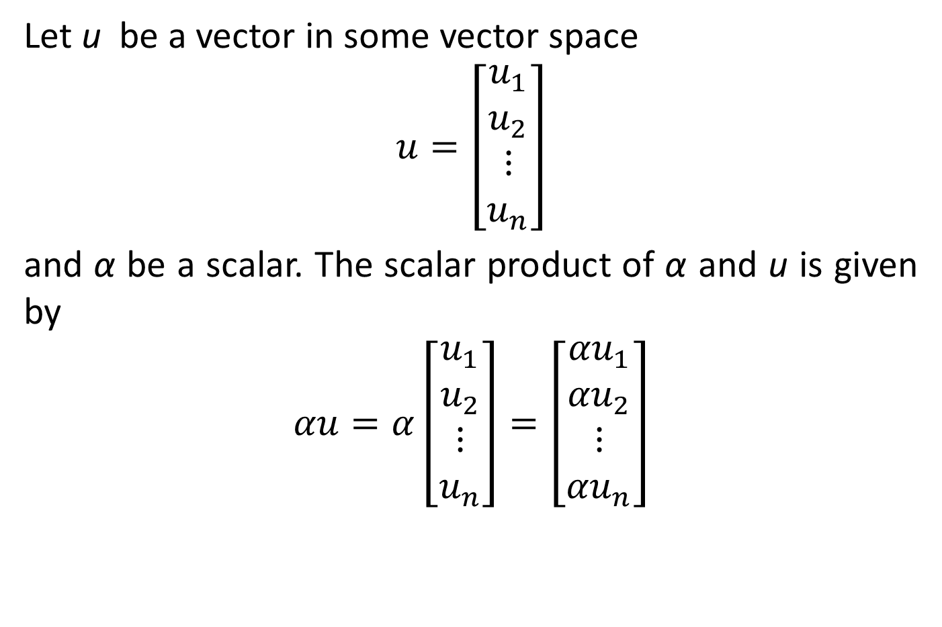
SCALAR MULTIPLICATION
Let u be a vector in some vector space
$$u=\left[\begin{matrix}u_{1} \\ u_{2} \\ ⋮ \\ u_{n}\end{matrix}\right]$$
and α be a scalar. The scalar product of α and u is given by
$$αu=α\left[\begin{matrix}u_{1} \\ u_{2} \\ ⋮ \\ u_{n}\end{matrix}\right]=\left[\begin{matrix}{αu}_{1} \\ {αu}_{2} \\ ⋮ \\ {αu}_{n}\end{matrix}\right]$$

Slide 11
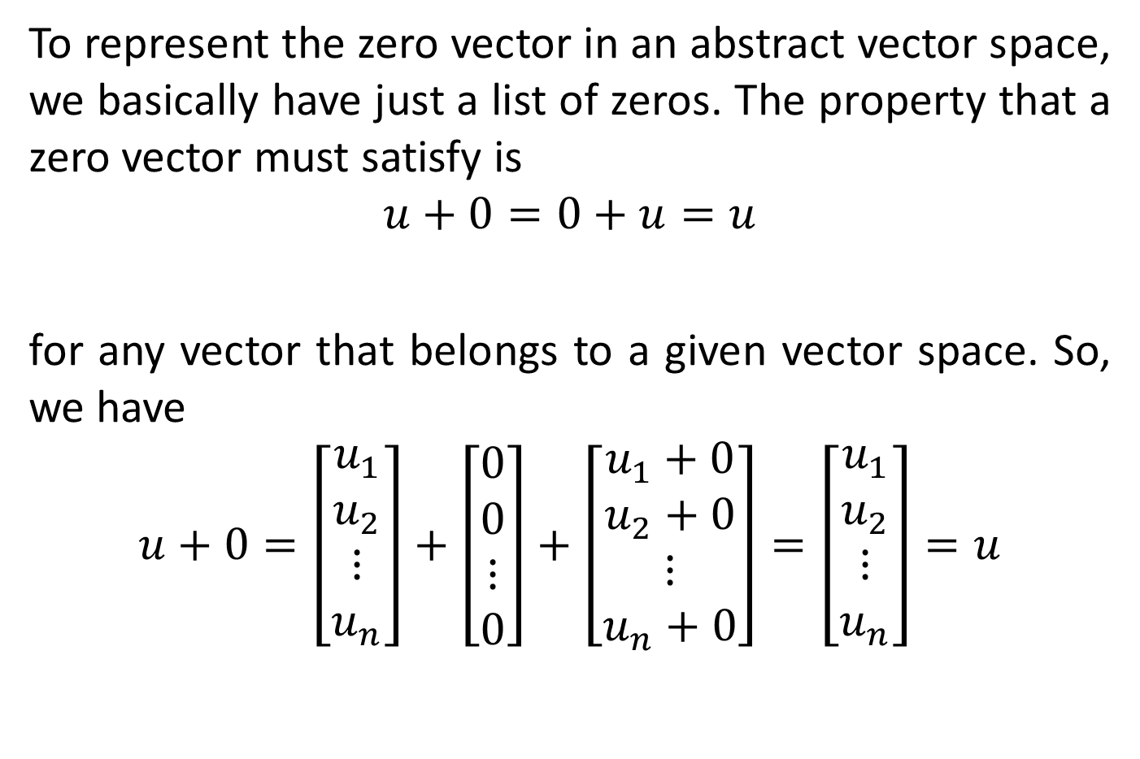
THE ZERO VECTOR
To represent the zero vector in an abstract vector space, we basically have just a list of zeros. The property that a zero vector must satisfy is
$$u+0=0+u=u$$
for any vector that belongs to a given vector space. So, we have
$$u+0=\left[\begin{matrix}u_{1} \\ u_{2} \\ ⋮ \\ u_{n}\end{matrix}\right]+\left[\begin{matrix}0 \\ 0 \\ ⋮ \\ 0\end{matrix}\right]+\left[\begin{matrix}u_{1}+0 \\ u_{2}+0 \\ ⋮ \\ u_{n}+0\end{matrix}\right]=\left[\begin{matrix}u_{1} \\ u_{2} \\ ⋮ \\ u_{n}\end{matrix}\right]=u$$

Slide 12

INVERSE OF A VECTOR
The inverse of a vector is found by negating all the components. If
$u=\left[\begin{matrix}u_{1} \\ u_{2} \\ ⋮ \\ u_{n}\end{matrix}\right]$, then
$$−u=\left[\begin{matrix}{−u}_{1} \\ {−u}_{2} \\ ⋮ \\ −u_{n}\end{matrix}\right]$$

Slide 13

THE TRANSPOSE OF A VECTOR
The transpose of a vector in $ℝ^{n}$ is a row vector.
$$u=\left[\begin{matrix}u_{1} \\ u_{2} \\ ⋮ \\ u_{n}\end{matrix}\right]$$
$$u_{T}=\left[\begin{matrix}u_{1} & u_{2} & ⋯ & u_{n}\end{matrix}\right]$$

Slide 14
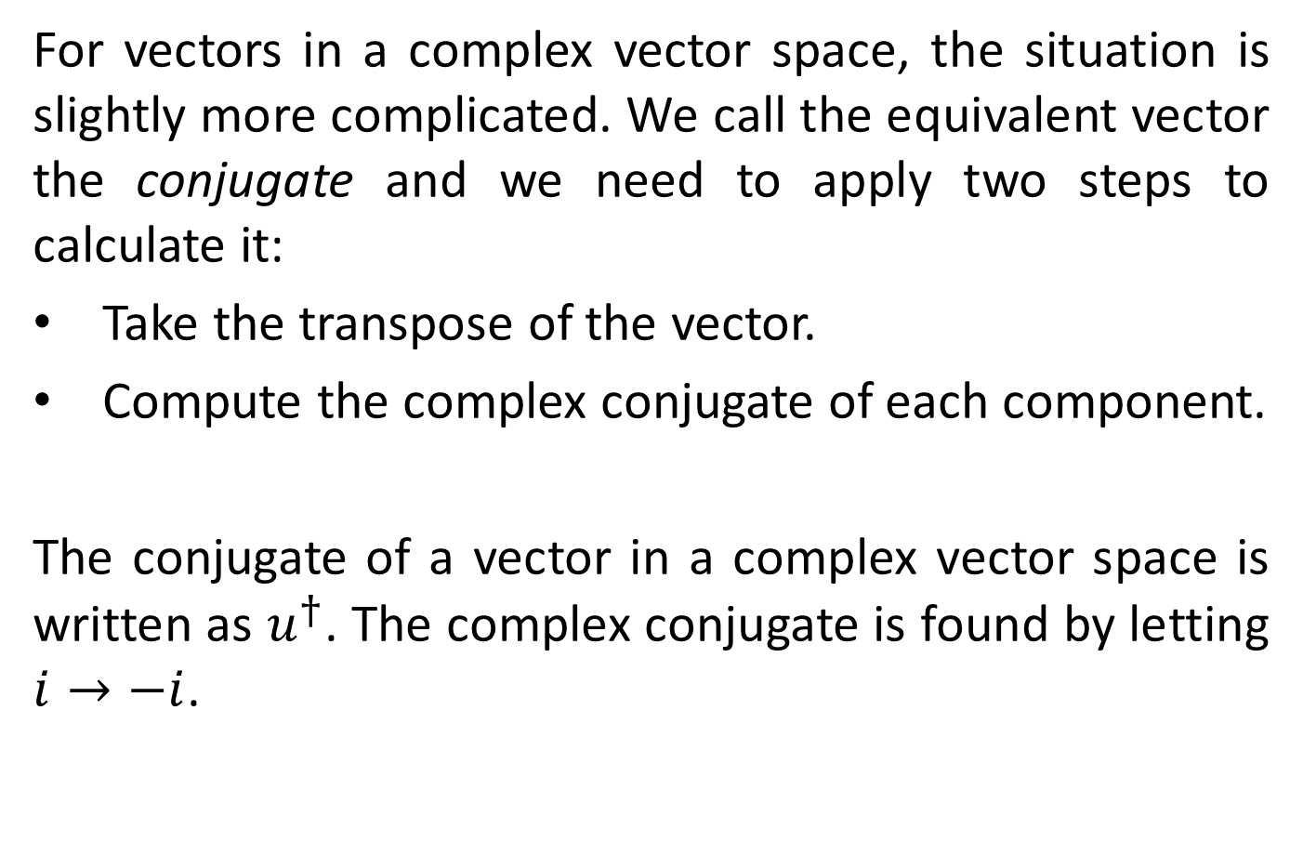
THE TRANSPOSE OF A VECTOR
For vectors in a complex vector space, the situation is slightly more complicated. We call the equivalent vector the conjugate and we need to apply two steps to calculate it:
Take the transpose of the vector.
Compute the complex conjugate of each component.
The conjugate of a vector in a complex vector space is written as $u^{†}$. The complex conjugate is found by letting $i→−i$.

Slide 15
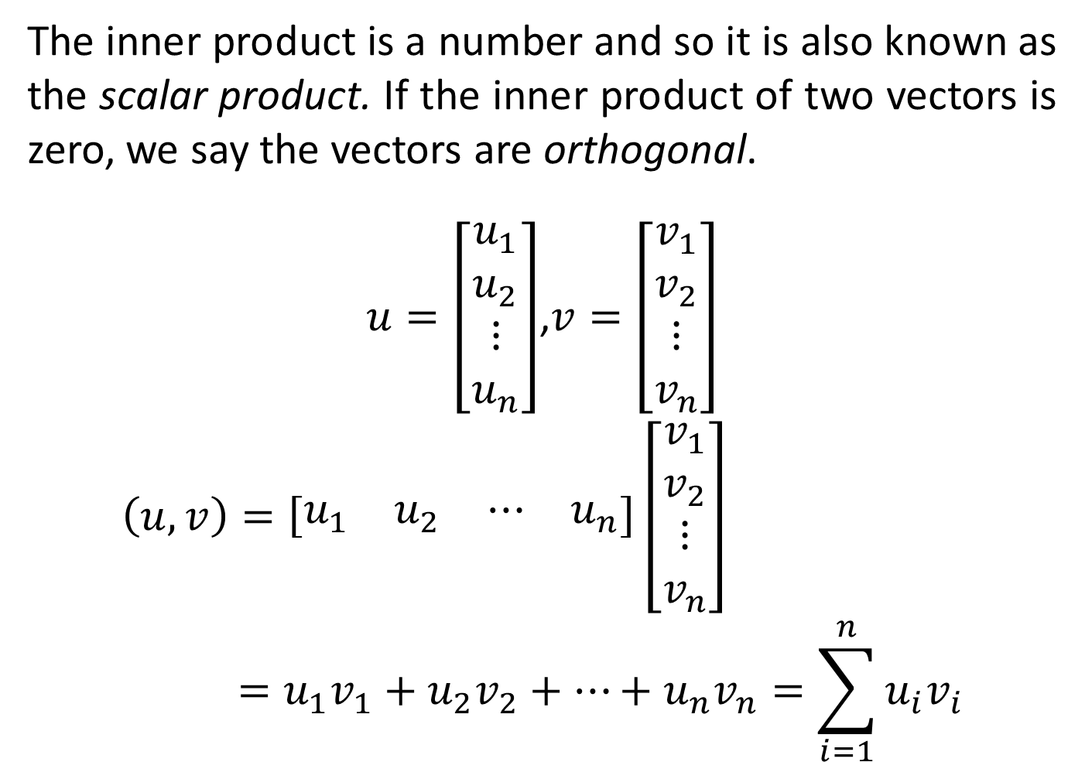
THE DOT OR INNER PRODUCT
The inner product is a number and so it is also known as the scalar product. If the inner product of two vectors is zero, we say the vectors are orthogonal.
$u=\left[\begin{matrix}u_{1} \\ u_{2} \\ ⋮ \\ u_{n}\end{matrix}\right]$,$v=\left[\begin{matrix}v_{1} \\ v_{2} \\ ⋮ \\ v_{n}\end{matrix}\right]$
$$\left(u, v\right)=\left[\begin{matrix}u_{1} & u_{2} & ⋯ & u_{n}\end{matrix}\right]\left[\begin{matrix}v_{1} \\ v_{2} \\ ⋮ \\ v_{n}\end{matrix}\right]=u_{1}v_{1}+u_{2}v_{2}+…+u_{n}v_{n}=\sum_{i=1}^{n}{u_{i}v_{i}}$$

Slide 16

THE NORM OF A VECTOR
$$\left\|u\right\|=\sqrt{\left(u, u\right)}=\sqrt{u_{1}^{2}+u_{2}^{2}+…+u_{n}^{2}}$$
Example:
Find the norm of $v=\left[\begin{matrix}2i \\ 4 \\ 1+i\end{matrix}\right]$.

Slide 17
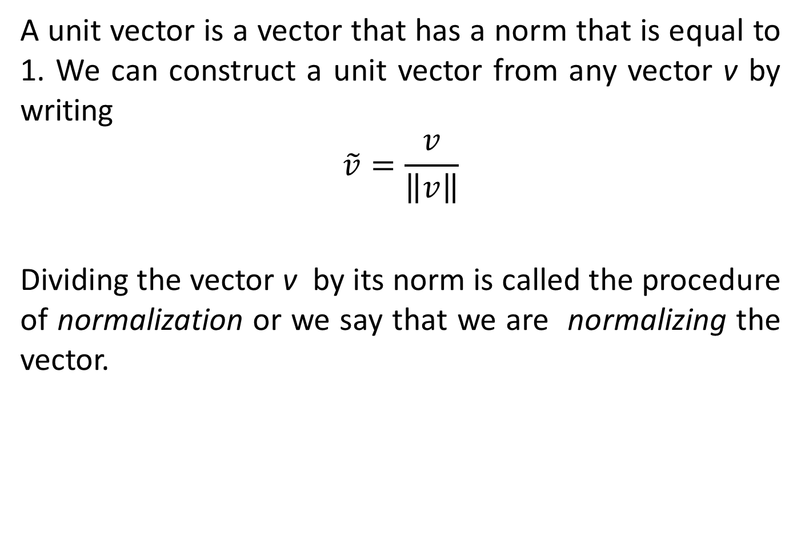
UNIT VECTOR
A unit vector is a vector that has a norm that is equal to 1. We can construct a unit vector from any vector v by writing
$$\tilde{v}=\frac{v}{\left\|v\right\|}$$
Dividing the vector v by its norm is called the procedure of normalization or we say that we are normalizing the vector.

Slide 18

THE ANGLE BETWEEN TWO VECTORS
The angle between two vectors u and v is
$$\cos{θ}=\frac{\left(u, v\right)}{\left\|u\right\|\left\|v\right\|}$$

Slide 19

TWO THEOREMS INVOLVING VECTORS
The Cauchy-Schartz inequality states that
$$\left|\left(u, v\right)\right|≤\left\|u\right\|\left\|v\right\|$$
and the triangle inequality says
$$\left\|u+v\right\|≤\left\|u\right\|+\left\|v\right\|$$

Slide 20

DISTANCE BETWEEN TWO VECTORS
This is given by
$$d\left(u, v\right)=\left\|u−v\right\|=\sqrt{{\left(u_{1}−v_{1}\right)}^{2}+{\left(u_{2}−v_{2}\right)}^{2}+…+{\left(u_{n}−v_{n}\right)}^{2}}$$

